Slide 1
AromaTouch Technique July 2017 Study Results
Tuesday, August 01, 2017

Slide 2
85
What effect does the AromaTouch Technique have on participant’s stress and anxiety levels?
Participants were asked to measure their level of stress, energy and pain before and after two individual AromaTouch Technique sessions performed within a 7 day period.
Total Responses
Date Created: Tuesday, August 1, 2017
Complete Responses: 85

Slide 3
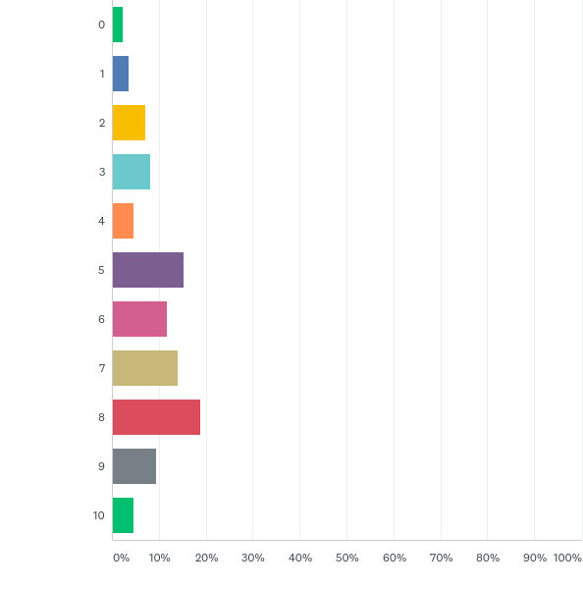
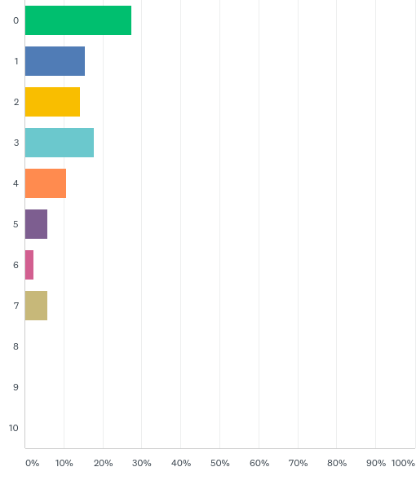
COMPARISON – SESSION #1: Rate your CURRENT level of STRESS
Answered: 85 Skipped: 0
No stress
PRE SESSION
POST SESSION
High stress

Slide 4
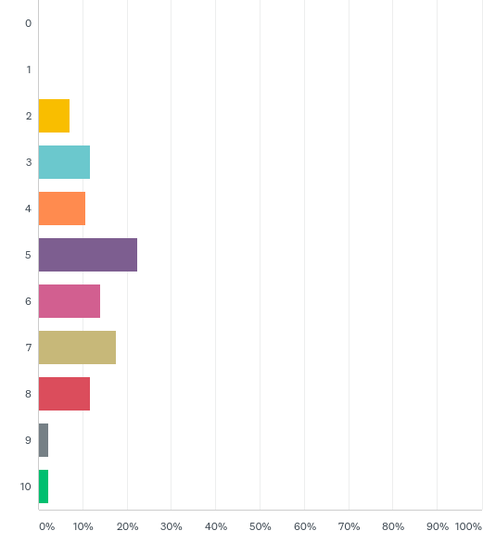
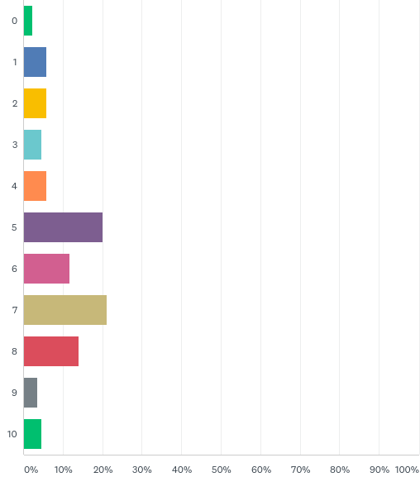
COMPARISON SESSION #1: Rate your CURRENT level of ENERGY
Answered: 85 Skipped: 0
Low energy
PRE SESSION
POST SESSION
High energy

Slide 5
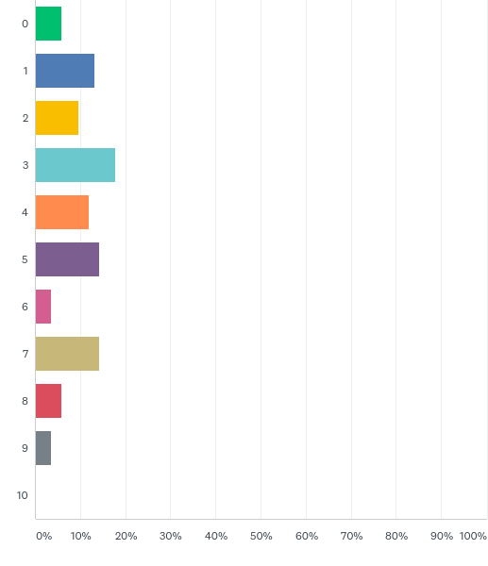
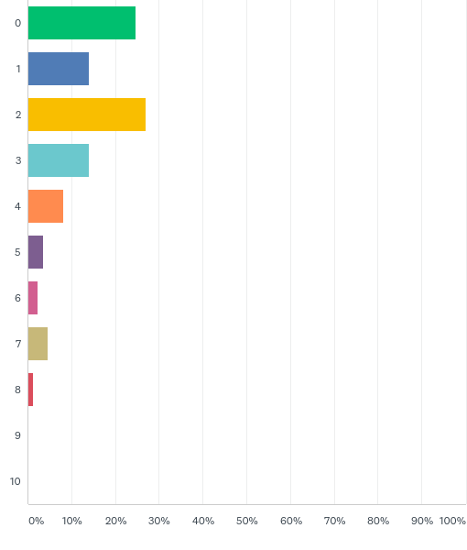
COMPARISON SESSION #1: Rate your CURRENT level of PHYSICAL PAIN
Answered: 84 Skipped: 1
Low pain
PRE SESSION
POST SESSION
High pain

Slide 6
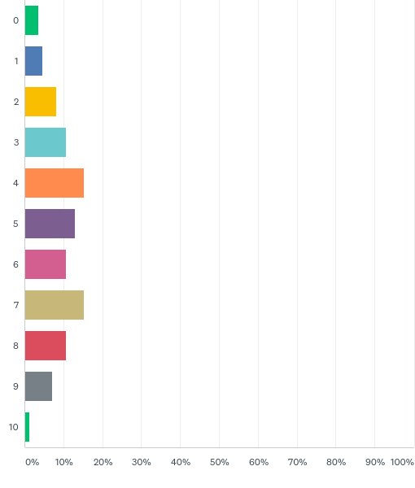
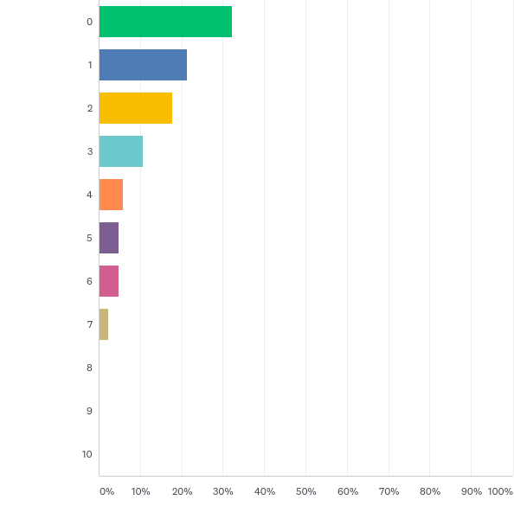
COMPARISON SESSION #2: Rate your CURRENT level of STRESS
Answered: 85 Skipped: 0
No stress
PRE SESSION
POST SESSION
High stress

Slide 7
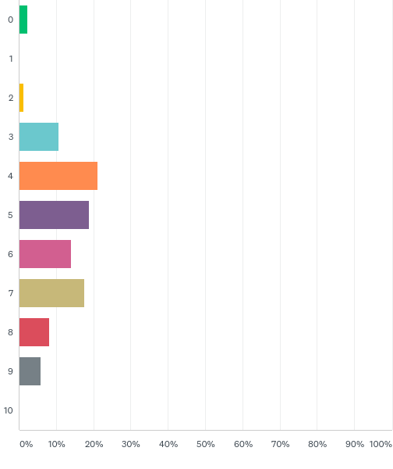
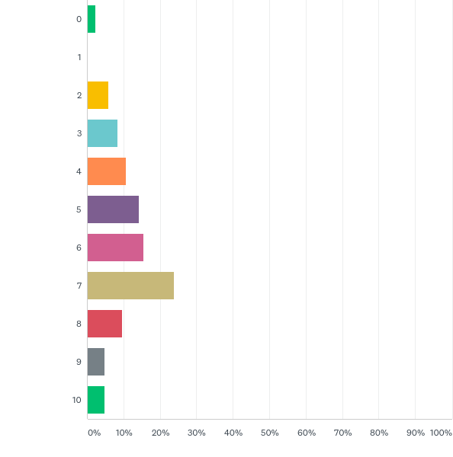
COMPARISON SESSION #2: Rate your CURRENT level of ENERGY
Answered: 85 Skipped: 0
Low energy
PRE SESSION
POST SESSION
High energy

Slide 8
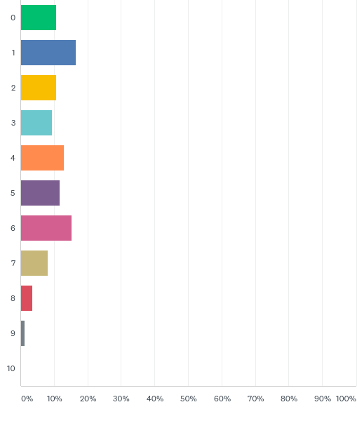
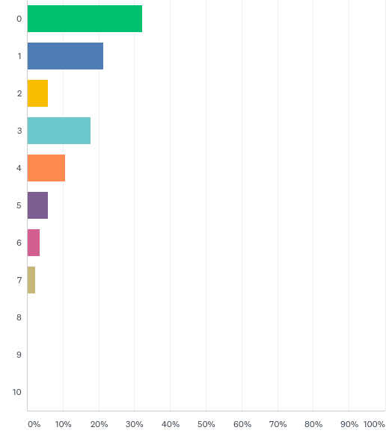
COMPARISON SESSION #2: Rate your CURRENT level of PHYSICAL PAIN
Answered: 85 Skipped: 0
Low pain
PRE SESSION
POST SESSION
High pain

Slide 9
Findings of Our Study:
Participants who received the doTERRA AromaTouch Technique
Significantly REDUCED Reported Stress Levels and Physical Pain Levels
Reported overall less stress at start of second session within the week
Did not significantly reduce or increase Energy Levels
Recommendation: doTERRA’s AromaTouch Technique provides significant benefits to recipients and to those providing treatment.

